Slide 1
MODELLING ENERGY LOSS IN Shock Absorber
Team: Jeel Shah, Manasvi Shah, Yashasvi Yadu, Pratistha Agrawal
Subject: Dynamic System Modelling (702MH0C023)
Course: .Tech Mechatronics, Sem IV | NMIMS MPSTME Mumbai
Category: D (Mechanical Systems) | Complexity: Medium
COs Exercised: [CO1, CO2, CO3, CO4, CO5] | Date: [20/04/2026]

Slide 2
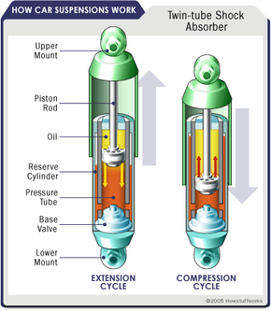
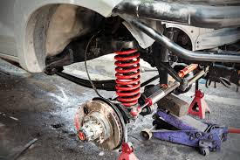
1. System Introduction & Motivation
What is the system?
A shock absorber is a mechanical device used in vehicle suspension systems to dissipate vibrational energy.
Why does it matter?
  Improves ride comfort
  Ensures tire-road contact
  Reduces structural damage
  How does a shock absorber dissipate energy over time due to damping?
Notes:
TIMING: 0:00-1:00 (1 min)
FOCUS: Introduce your system and its real-world engineering relevance.
TIP: Start with a compelling application, not a textbook definition.
SHOW: An image or short video of the actual system.

Slide 3
2. Problem Formulation & Assumptions
Inputs: External force F(t)
Outputs: Displacement x(t)
State Variables: x, x˙
Parameters:
  Mass m
  Damping coefficient c
  Spring stiffness k
DOF: 1 DOF (vertical motion only)
Assumptions:
  Linear spring → F=kx
  Viscous damping → F_{d}=cx
  No friction except damping
  Small oscillations (linear system)
Notes:
TIMING: 1:00-2:30 (1.5 min)
FOCUS: Clearly define I/O, states, parameters, DOF, and justify every assumption.
TIP: Explain WHY each assumption is physically valid.
BE PREPARED: You may be asked 'Why this assumption? What if it changes?'

Slide 4
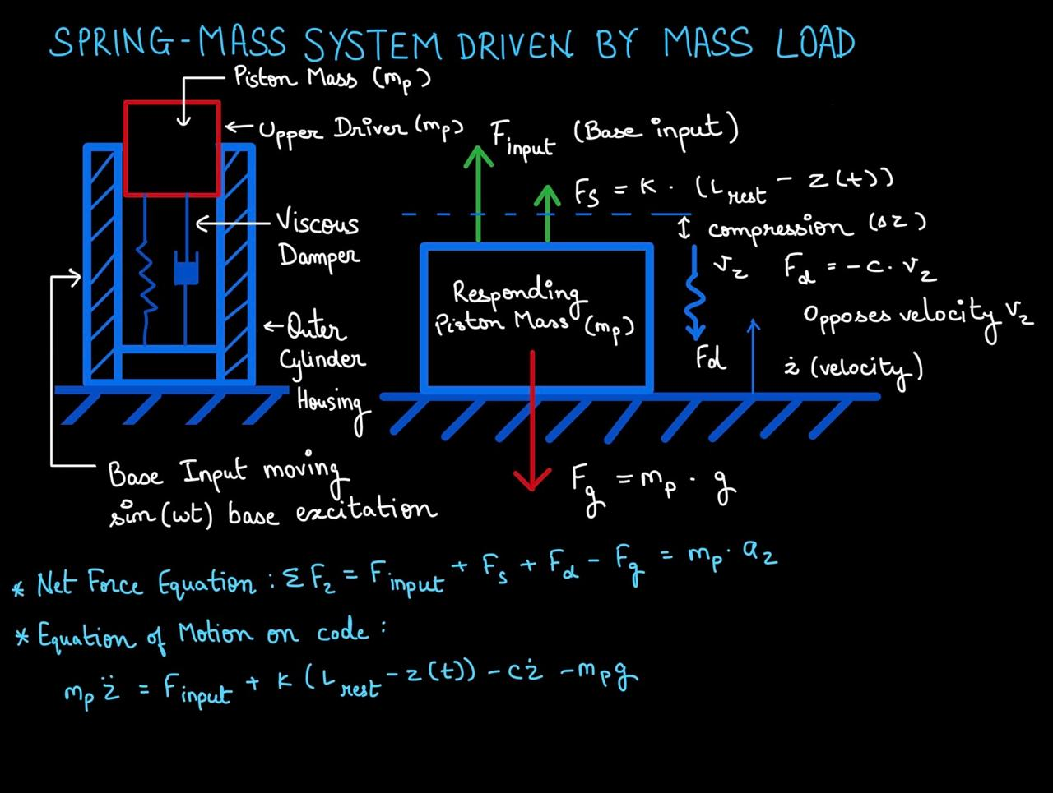
3. Free Body Diagram / System Schematic

Slide 5

4. Mathematical Derivation (Part 1)
Method: Newton's Second Law
Why? - We applied Newton’s second law considering all forces from FBD.
Forces acting: Spring force = $−kx,$Damping force = $−c\dot{x}$
⅀F = mx
Equation of motion:
$$m\ddot{x}+c\dot{x}+kx=0$$
Multiply by velocity:
mx’’x’ + cx’² + kxx’=0
Convert into Energy Terms:
(i) Kinetic Energy Term
$$m\ddot{x}\dot{x}=\frac{d}{dt}\left(\frac{1}{2}m{\dot{x}}^{2}\right)$$
(ii) Potential Energy Term
$$kx\dot{x}=\frac{d}{dt}\left(\frac{1}{2}kx^{2}\right)$$
Notes:
TIMING: 2:30-3:45 (1.25 min)
FOCUS: Walk through EVERY step of the derivation. This is the most important section.
TIP: Show the algebra — don't skip to the final equation.
BE PREPARED: You may be asked to explain any step in detail.

Slide 6

5. Final Equations & State-Space
Substitute Back
$$\frac{d}{dt}\left(\frac{1}{2}m{\dot{x}}^{2}\right)+\frac{d}{dt}\left(\frac{1}{2}kx^{2}\right)+c{\dot{x}}^{2}=0$$
Total Energy Equation: Combine terms:
$$\frac{d}{dt}\left(\frac{1}{2}m{\dot{x}}^{2}+\frac{1}{2}kx^{2}\right)=−c{\dot{x}}^{2}$$
Final Energy Loss Expression
$$\frac{dE}{dt}=−c{\dot{x}}^{2}$$
Where:
$$E=\frac{1}{2}m{\dot{x}}^{2}+\frac{1}{2}kx^{2}$$
Notes:
TIMING: 3:45-5:00 (1.25 min)
FOCUS: Present final EOM and state-space. Explain the physical meaning of EVERY term.
TIP: 'c*x_dot = viscous damping force' is stronger than just showing the equation.

Slide 7
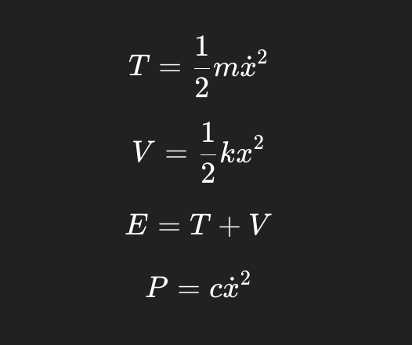
6. Simulation & Energy Analysis
Tools: Python (NumPy, SciPy, Matplotlib)
Energy Equations:
Code Snippet:
def model(t, y):
x, v = y
dx/dt = v
dv/dt = (F - c*v - k*x)/m
return [dx/dt, dv/dt]
Notes:
TIMING: 5:00-7:00 (2 min)
FOCUS: Show your simulation setup, key code snippet, and output plots.
INCLUDE: Energy vs time plot — this validates your model physically.
BE PREPARED: You may be asked 'Why does the oscillation decay?' or 'How does energy change?'

Slide 8
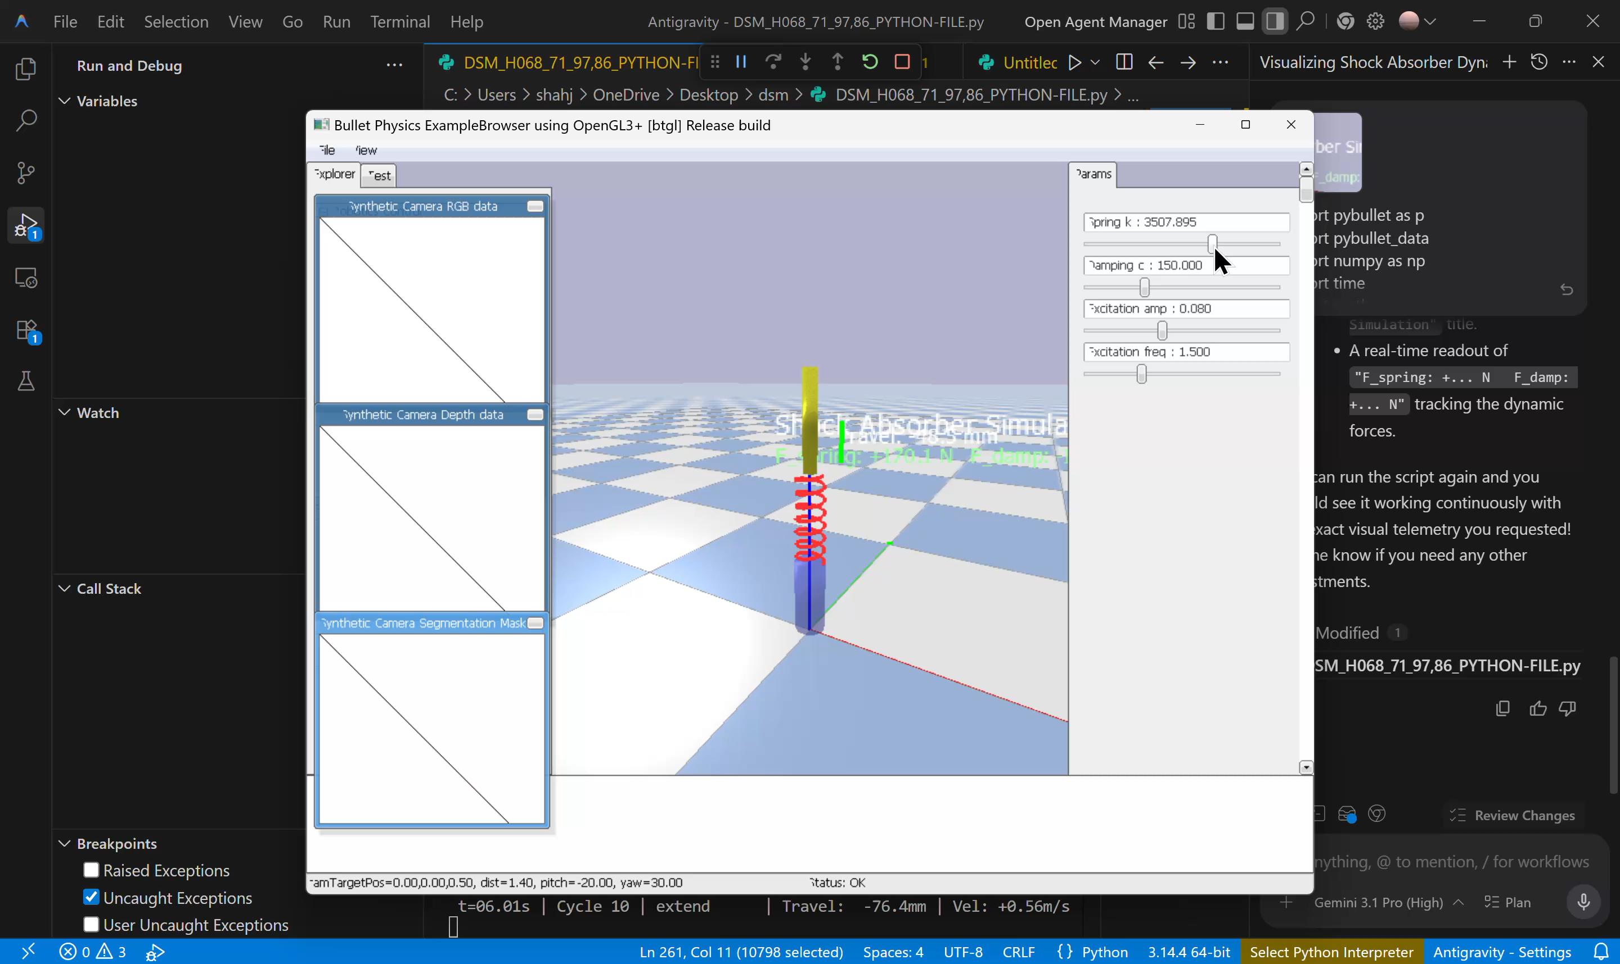
7. Simulation Visualization

Slide 9
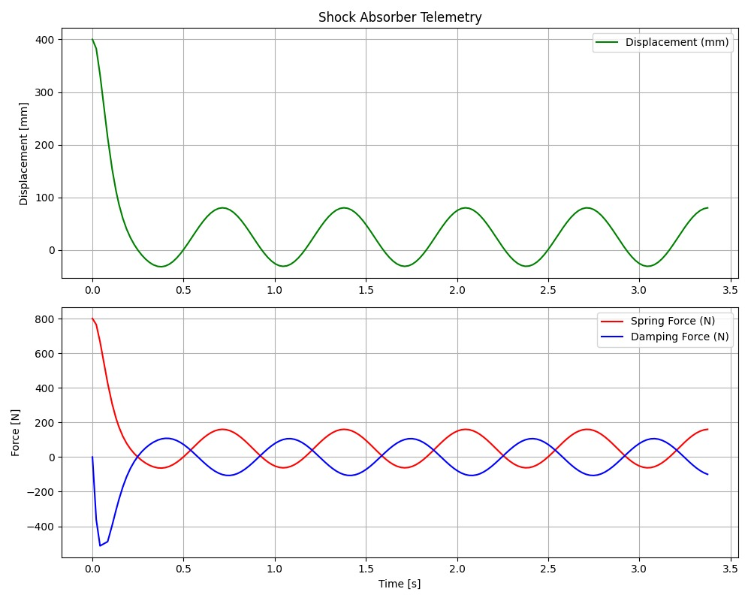

Slide 10
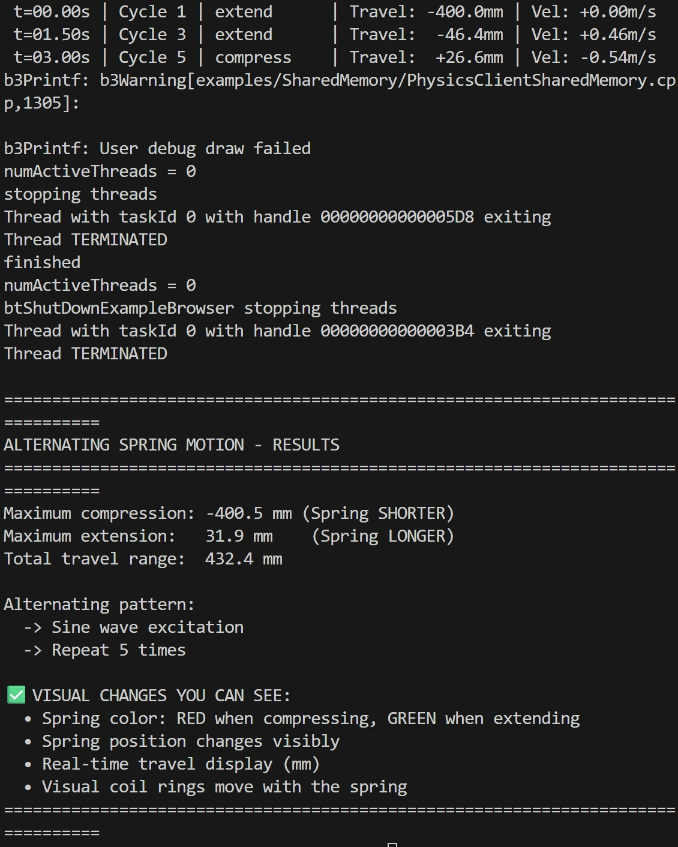
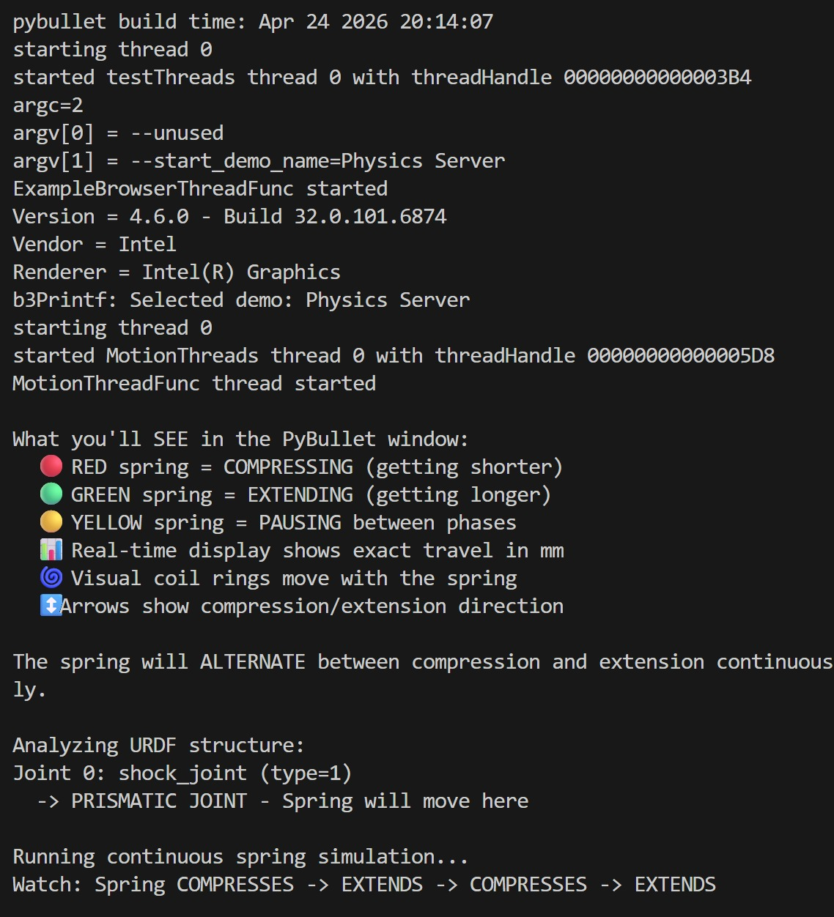

Slide 11
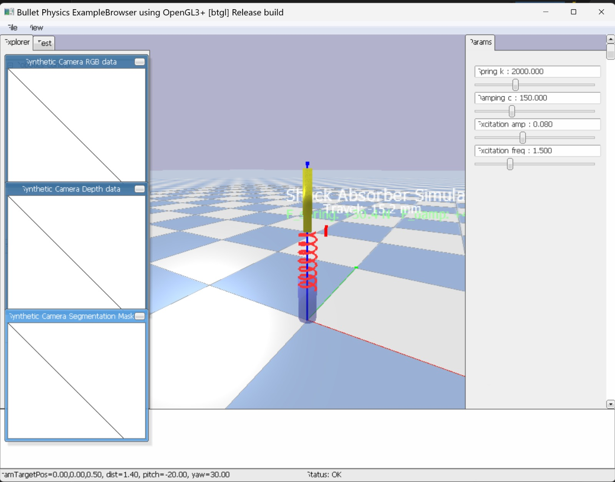

Slide 12
8. Validation & Analysis
Validation:
Energy decreses due to damping
Matches theory of damped system
Sensitivity:
Increase c → faster decay
Increase k → higher frequency
Limitations:
Linear model only
No real fluid modeling
Notes:
TIMING: 7:00-8:30 (1.5 min)
FOCUS: Show HOW you verified your results. Energy check, textbook comparison, sensitivity.
TIP: A strong answer = 'We compared natural frequency with Ginsberg Ch.3.'
A weak answer = 'It runs and produces output.'

Slide 13
9. Conclusions & Reflections
Key Finding:
  The shock absorber behaves as a mass–spring–damper system with damped oscillations.
  Energy dissipates over time due to viscous damping (cx’), converting mechanical energy into heat.
  The system shows exponential decay in amplitude, confirming realistic physical behavior.
  Simulation results match theoretical expectations, validating the mathematical model.
What we learned that a textbook couldn't teach:
  The importance of correct sign convention in FBD and equations—small mistakes change results completely.
  How to connect mathematical equations with physical meaning (especially damping and energy loss).
  Practical understanding of energy decay and power dissipation, not just formulas.
  Difficulty in translating real-world systems into simplified models with justified assumptions.
  CO4 & CO5 were most challenging due to derivation and energy interpretation.
What we would do differently (Point-wise)
  Start with a clear and verified Free Body Diagram earlier.
  Fix sign conventions before derivation to avoid rework.
  Perform parameter sensitivity analysis earlier in the process.
Notes:
TIMING: 8:30-10:00 (1.5 min)
FOCUS: Be specific about what you learned and what was hardest.
TIP: 'Getting the sign convention right in the Lagrangian took 3 iterations' is much stronger than 'teamwork was hard.'
INCLUDE: CO self-assessment — which COs did you exercise most?

Slide 14
10. References & AI Disclosure
Textbook References:
  Ginsberg, J. H.
  Engineering Dynamics, Cambridge University Press, 2007.
  Friedmann, P. P., Lesieutre, G. A., Huang, D.
  Structural Dynamics: Theory and Applications, Cambridge University Press, 2023.
Online Resources:
  “Damping – Theory and Applications,”
  Wikipedia (Engineering reference overview)
  https://en.wikipedia.org/wiki/Damping?utm_source=chatgpt.com
AI Tools :
  ChatGPT (OpenAI)
  Used for:
  Python code guidance
  Concept explanation
  NOT used for: Mathematical derivation (done manually)
Notes:
AI disclosure is MANDATORY but NOT penalized.
Be honest about what tools you used and for what purpose.
Good: 'Used ChatGPT for Python syntax debugging, derivation done by hand.'
Non-disclosure IS penalized if uncovered during Q&A.

Slide 15
Thank You — Questions?
Team: Jeel Shah, Manasvi Shah, Yashasvi Yadu, Pratistha Agrawal
Course: Dynamic System Modeling (702MH0C023)
B.Tech Mechatronics, Sem IV | NMIMS MPSTME Mumbai
Category: D (Mechanical Systems) | Complexity: Medium

